Slide 1
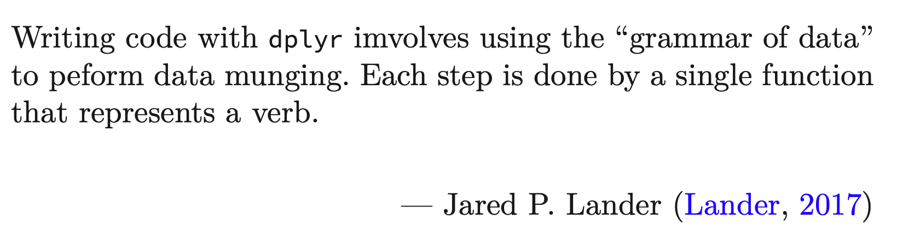
Data Science for Operational Researchers using R
06 – dplyr
https://github.com/JimDuggan/explore_or

Slide 2
Course Overview
Topic | Description
 | Session 1 (half-day)
1 | Introduction to R and Posit Cloud
2 | Atomic Vectors
3 | Functions, Lists and Functionals
4 | Data Frames and Tibble
5 | ggplot2
 | Session 2 (half-day)
6 | Data transformation with dplyr
7 | Relational Data with dplyr
8 | Processing data with purrr
9 | Exploratory Data Analysis – Examples

Slide 3
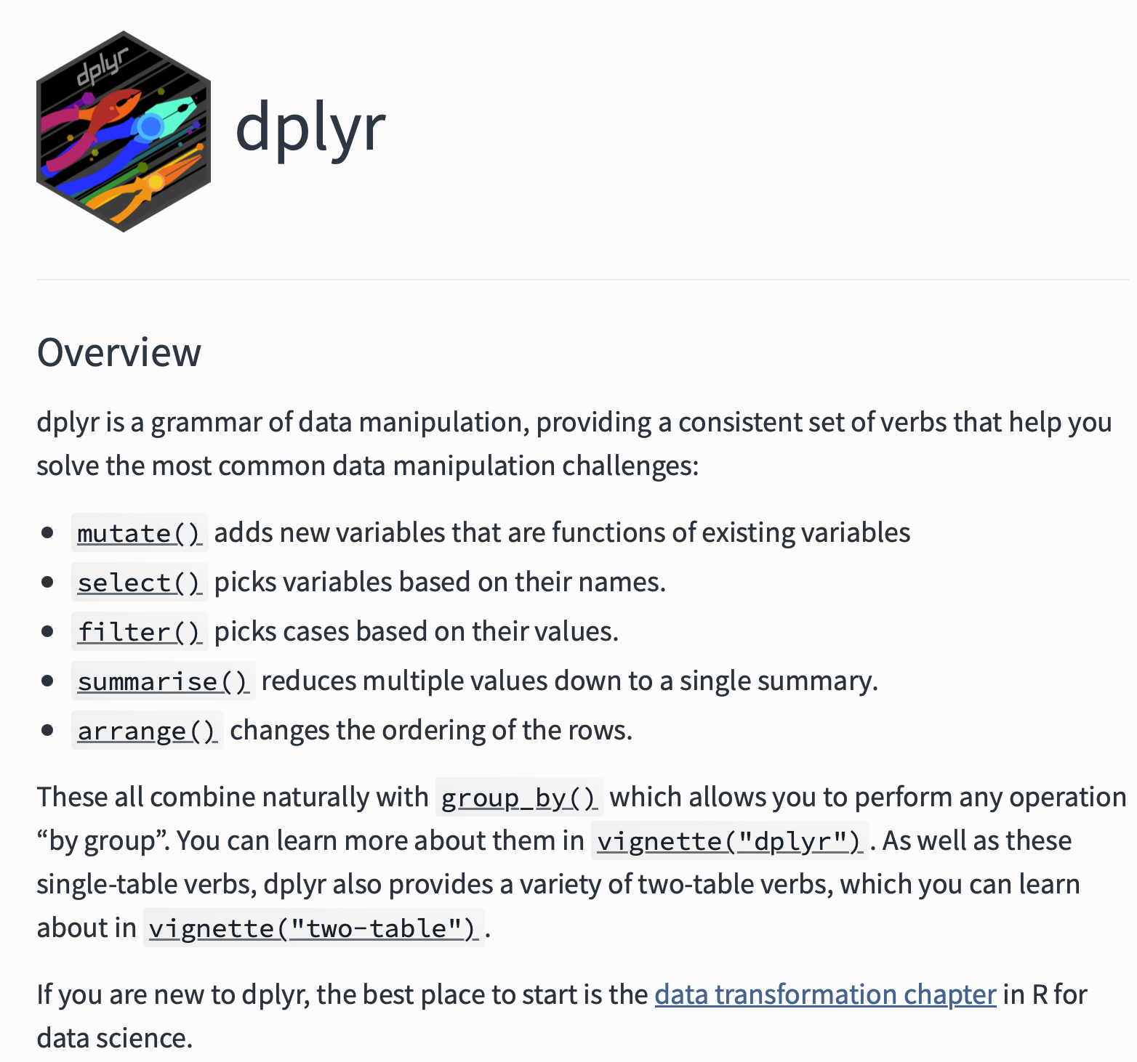
Overview
dplyr provides similar functionality to subset() and transform(), while also supporting aggregation of data
“tibble in, tibble out”
Elegant architecture, based on the “5 verbs”
Makes us of the tidyverse pipe %>%
https://dplyr.tidyverse.org

Slide 4
dplyr Basics: 5 key functions
Function | Purpose
filter() | Pick observations by their values
arrange() | Reorder the rows
select() | Pick variables by their names
mutate() | Create new variables with functions of existing variables
summarise() | Collapse many values down to a single summary
”A grammar of data manipulation”
All verbs (functions) work similarly
The first argument is a data frame/tibble
The subsequent arguments decide what to do with the data frame/tibble
The result (data frame/tibble) supports chaining of steps – NOTE the “pipe operator” which we will cover later.
https://dplyr.tidyverse.org

Slide 5
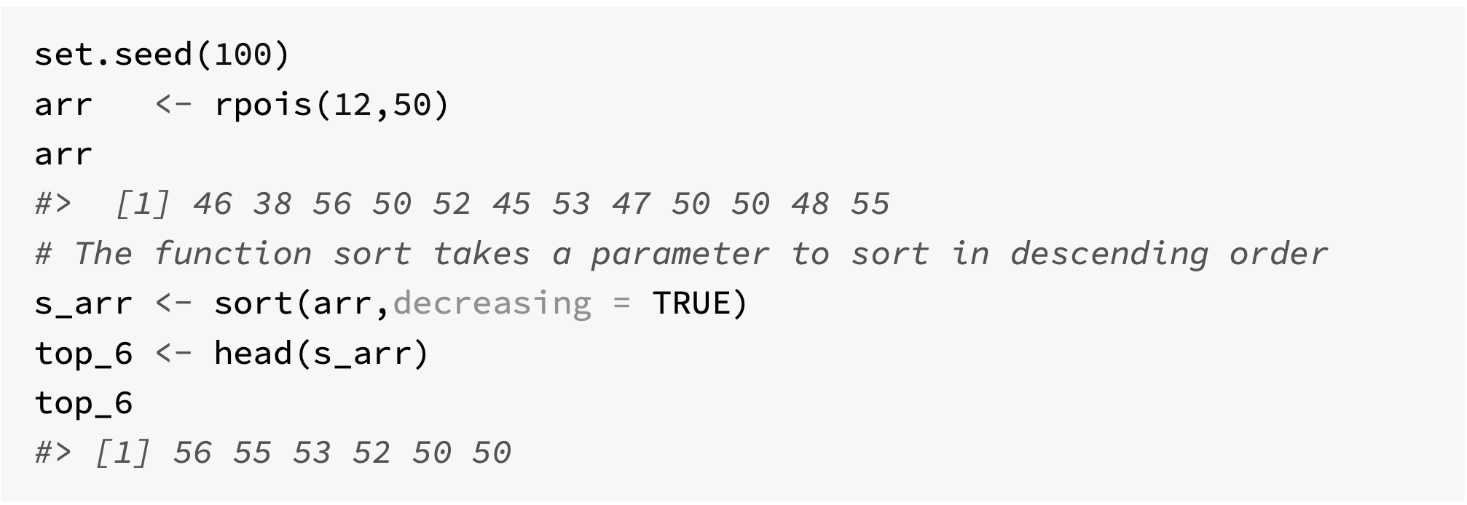
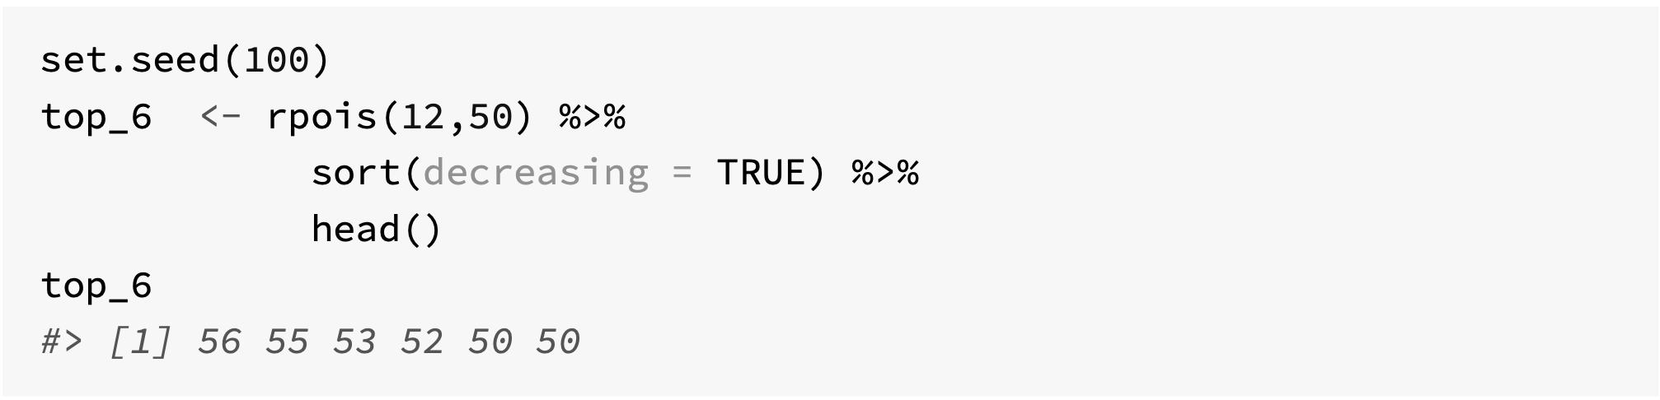
The tidyverse pipe - magrittr

Slide 6
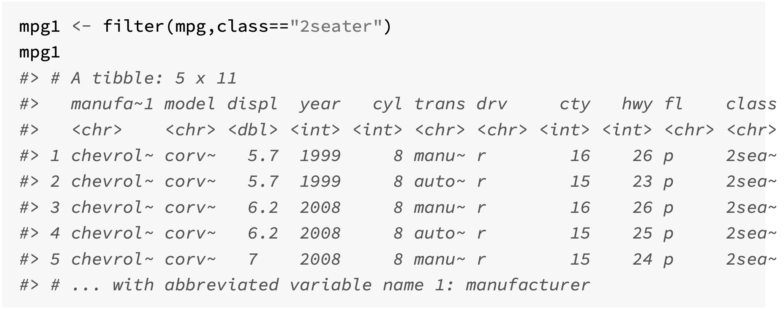
(1) Filtering rows with filter()
Used to subset a tibble
Arguments
A data frame/tibble
A list of expressions that return a logical value and are defined in terms of variables that are present in the data frame
All columns returned

Slide 7
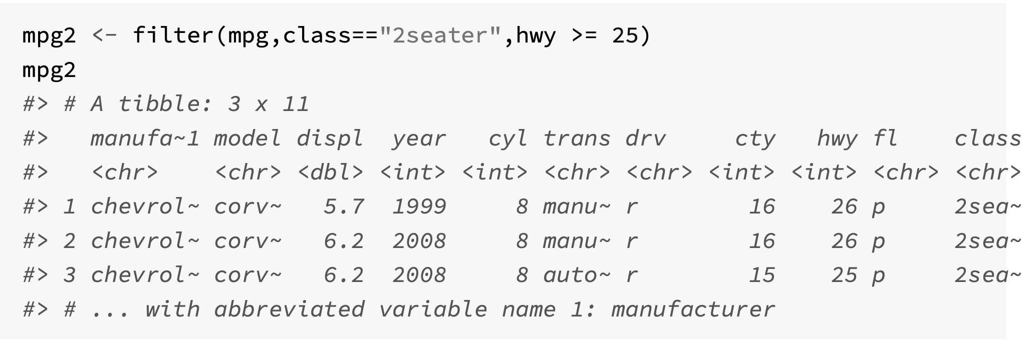
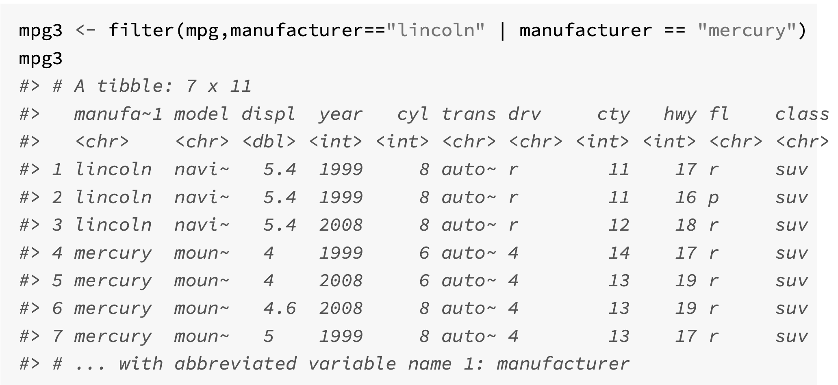

Slide 8
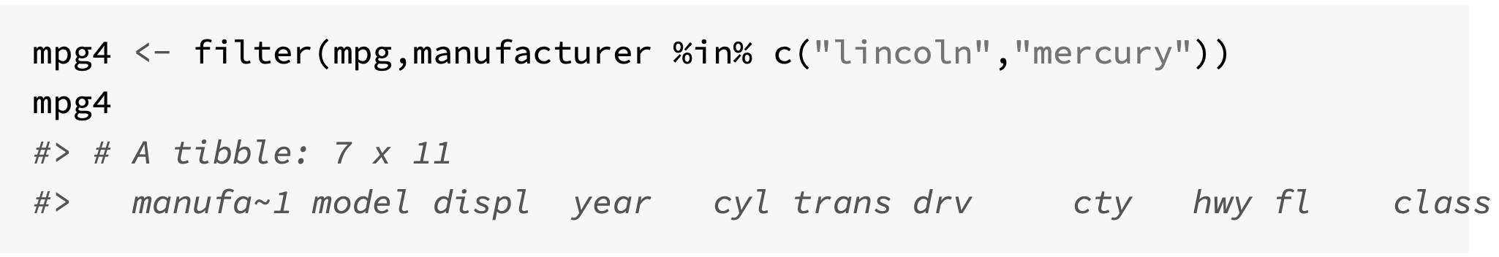
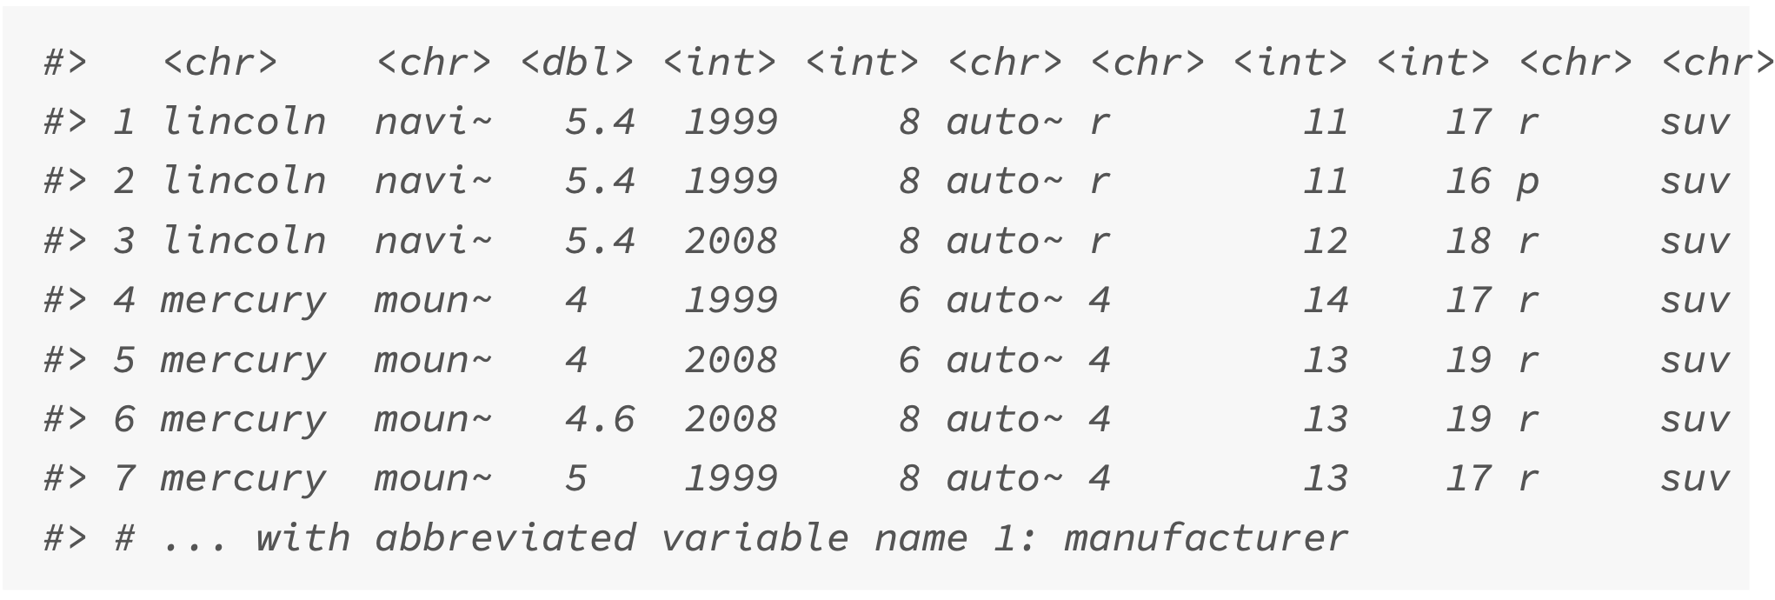

Slide 9
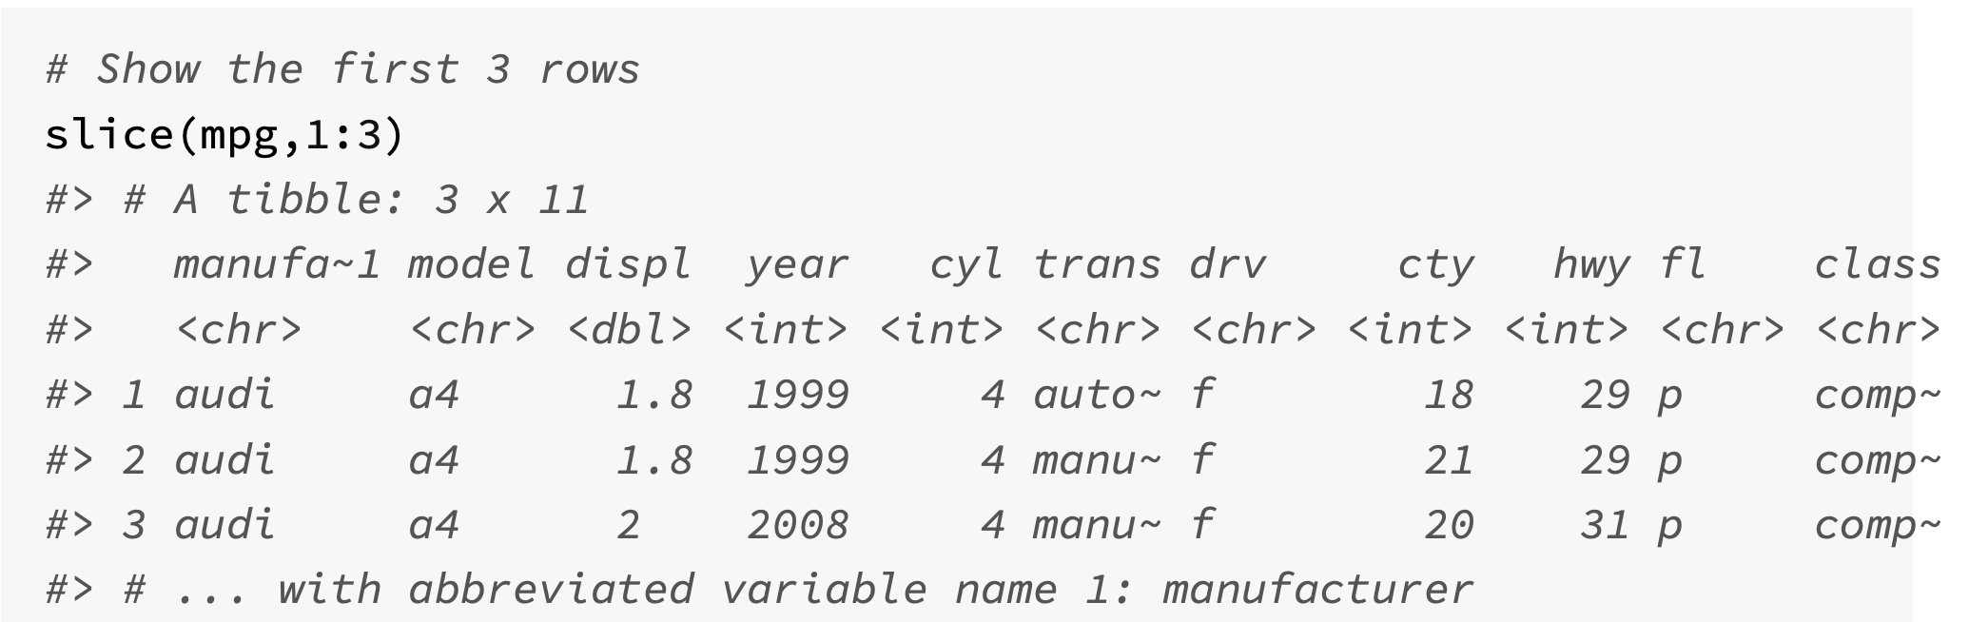
The slice() function

Slide 10
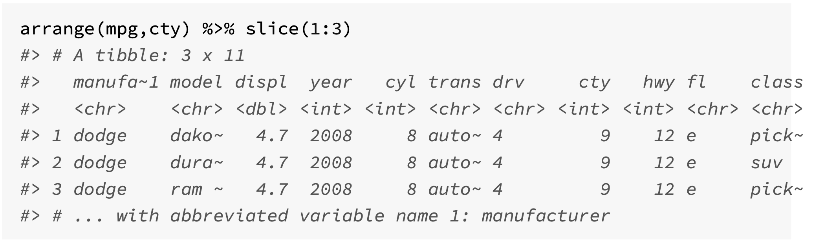
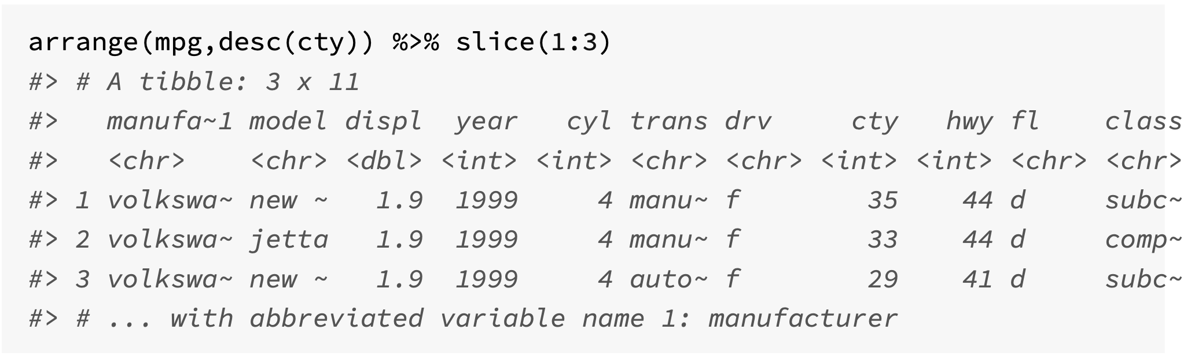
(2) Sorting rows with arrange()

Slide 11
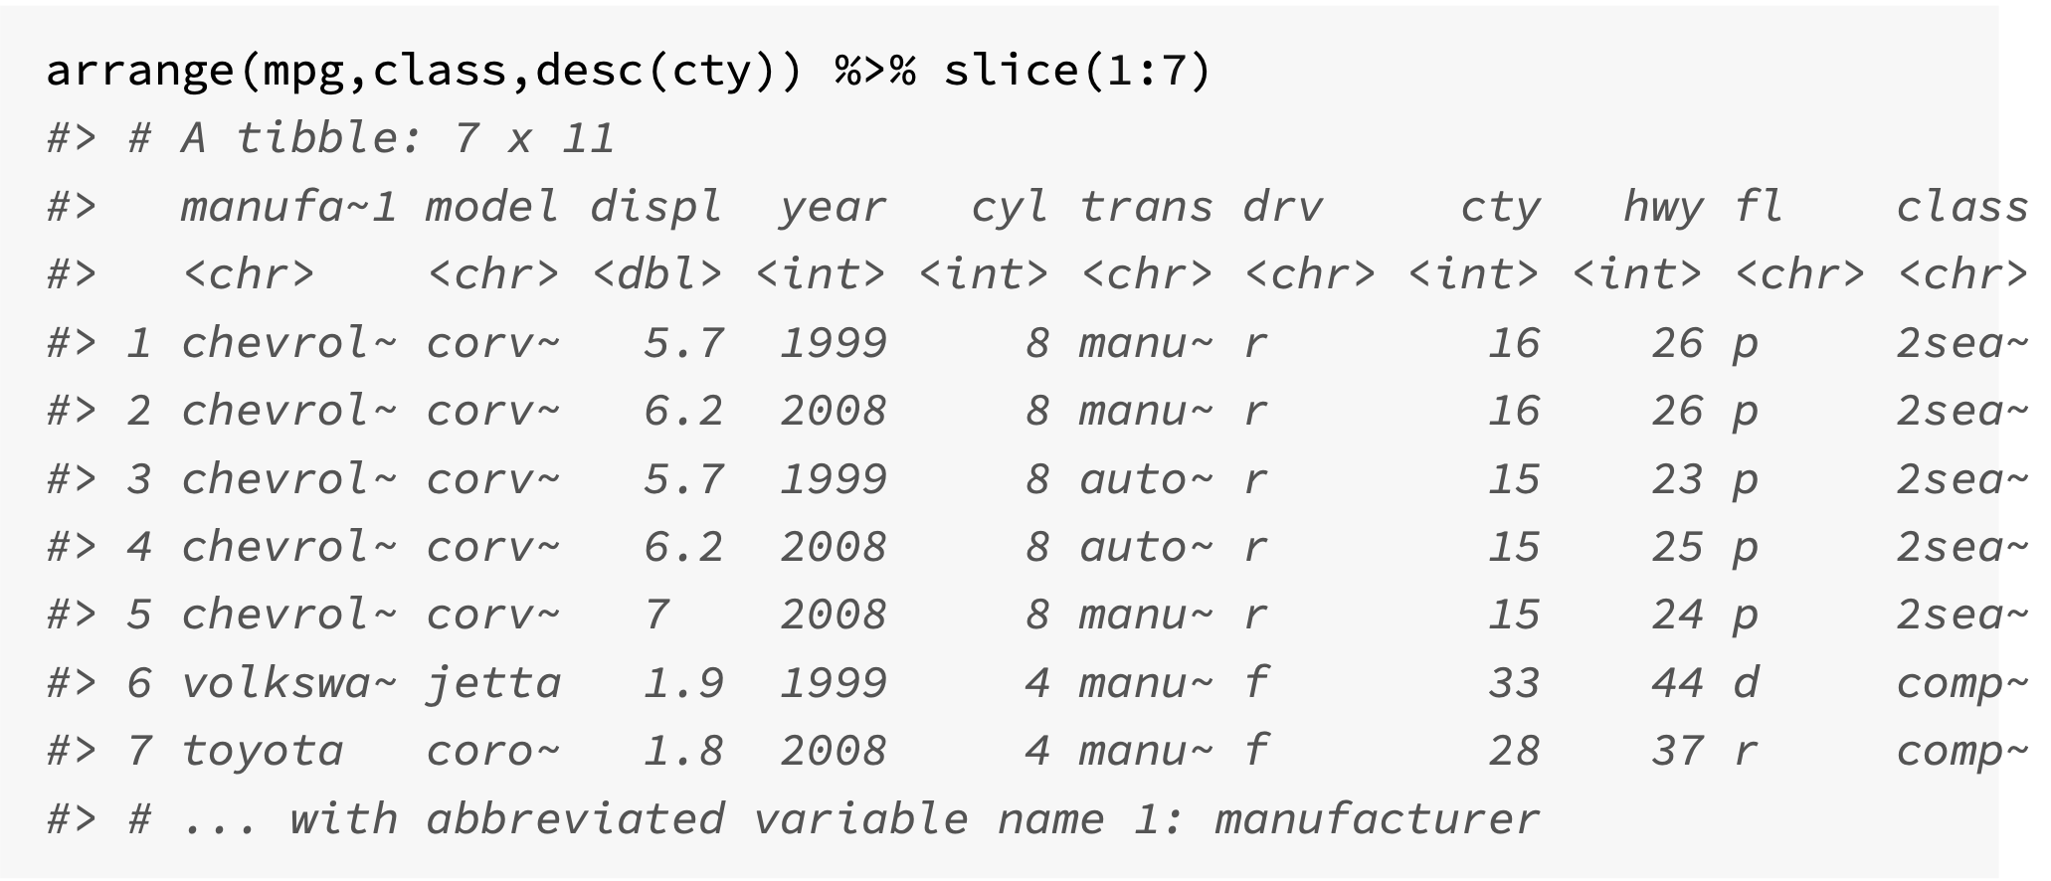
Using more than one sorting variable

Slide 12
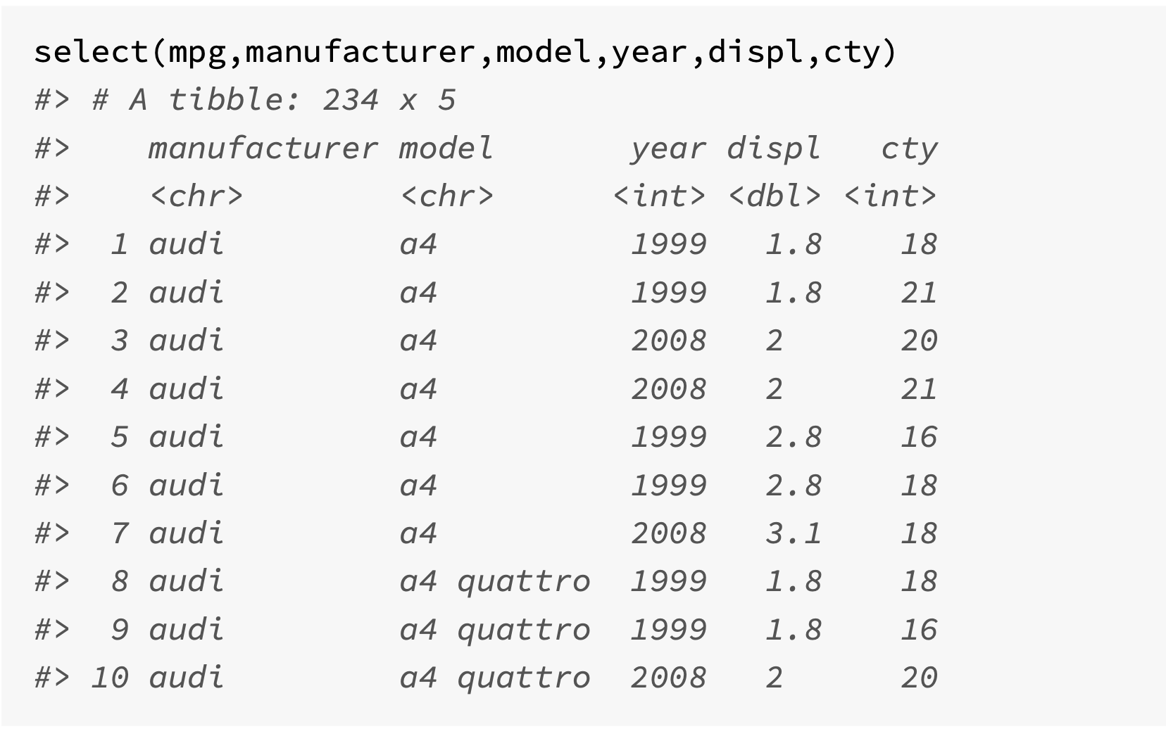
(3) Choosing columns with select()
Enables you to subset columns from the input tibble
select() will always return all the observations
Simplest use is to write the column names that are required.

Slide 13
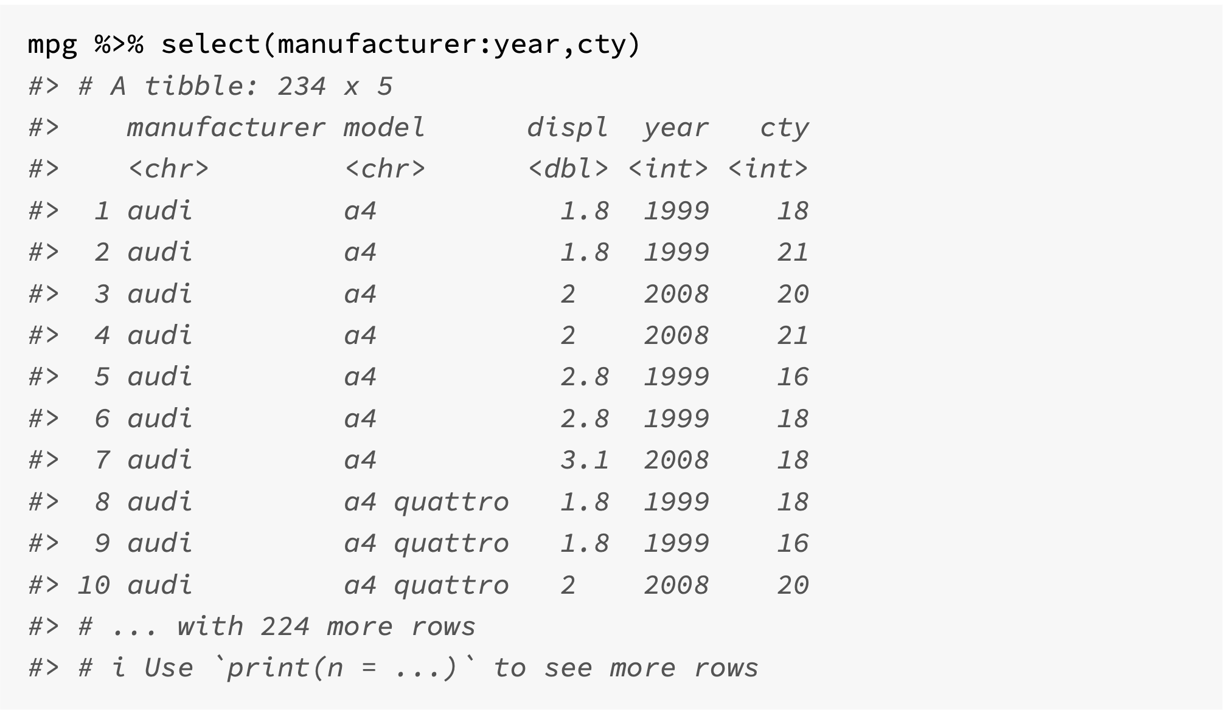
Use : for selecting a range of consecutive variables

Slide 14
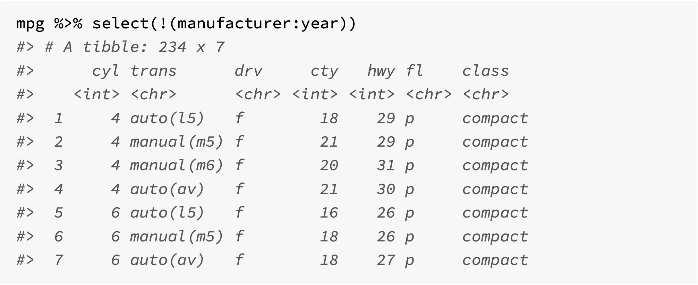
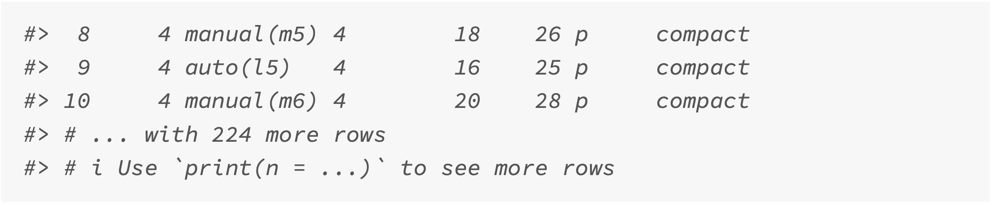
! For the complement of a collection of variables

Slide 15
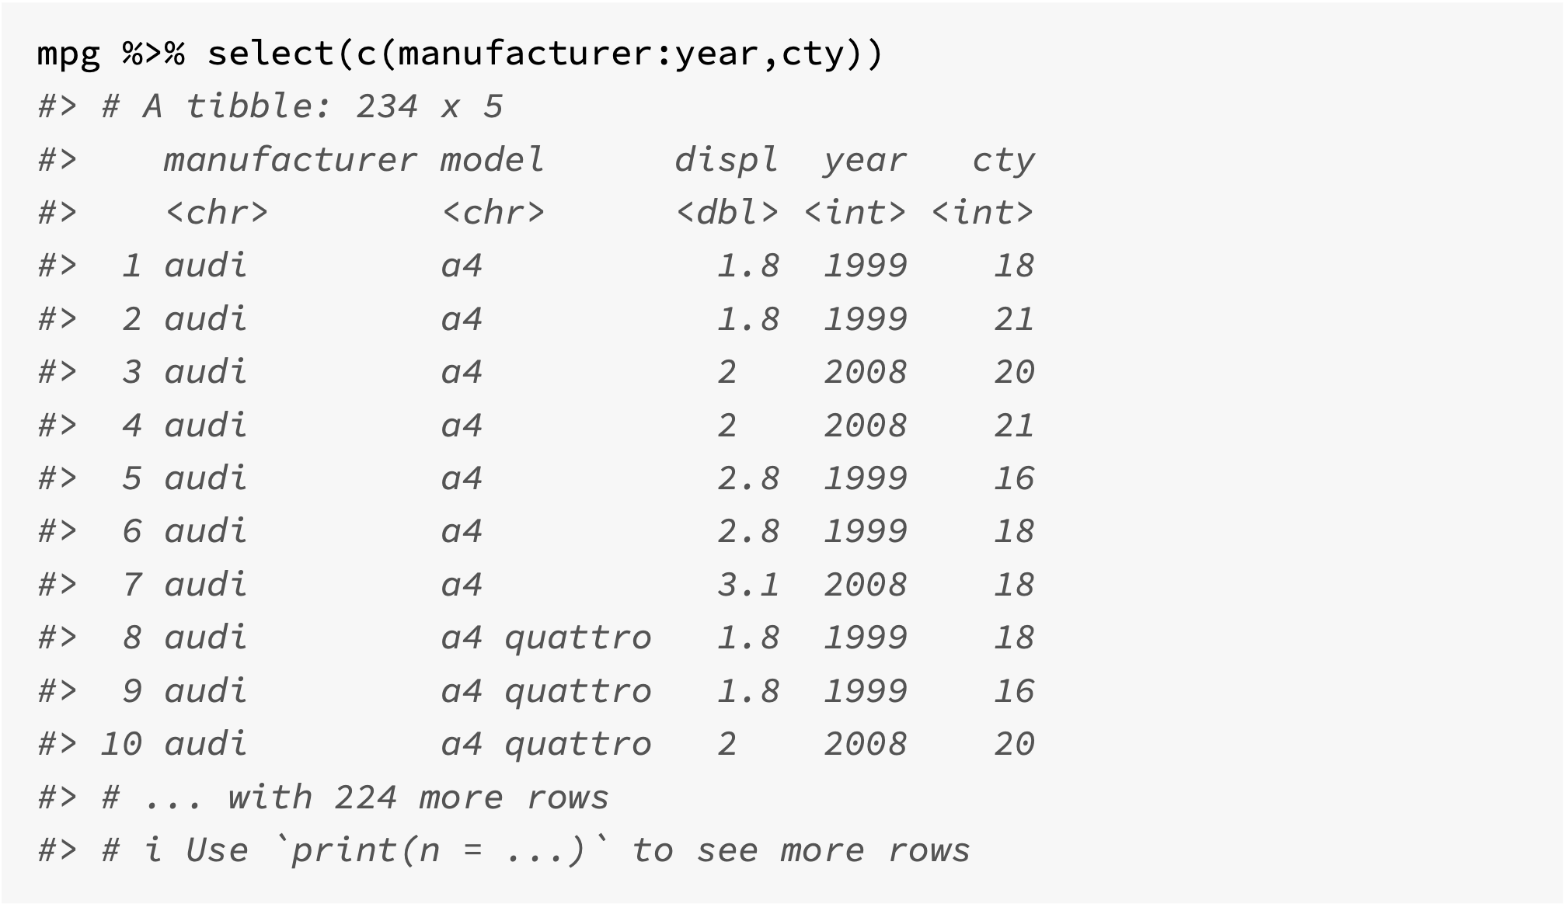
c() for combining selections

Slide 16
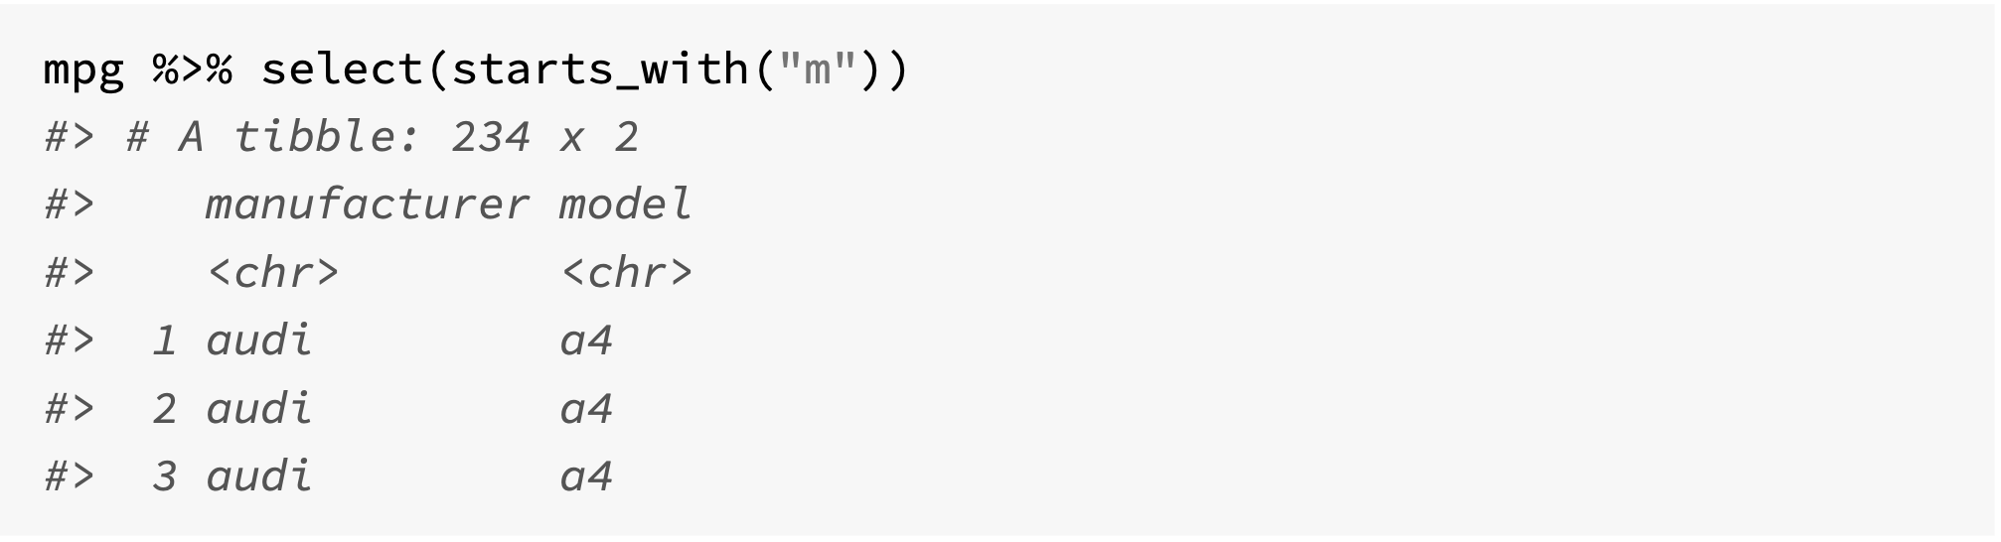
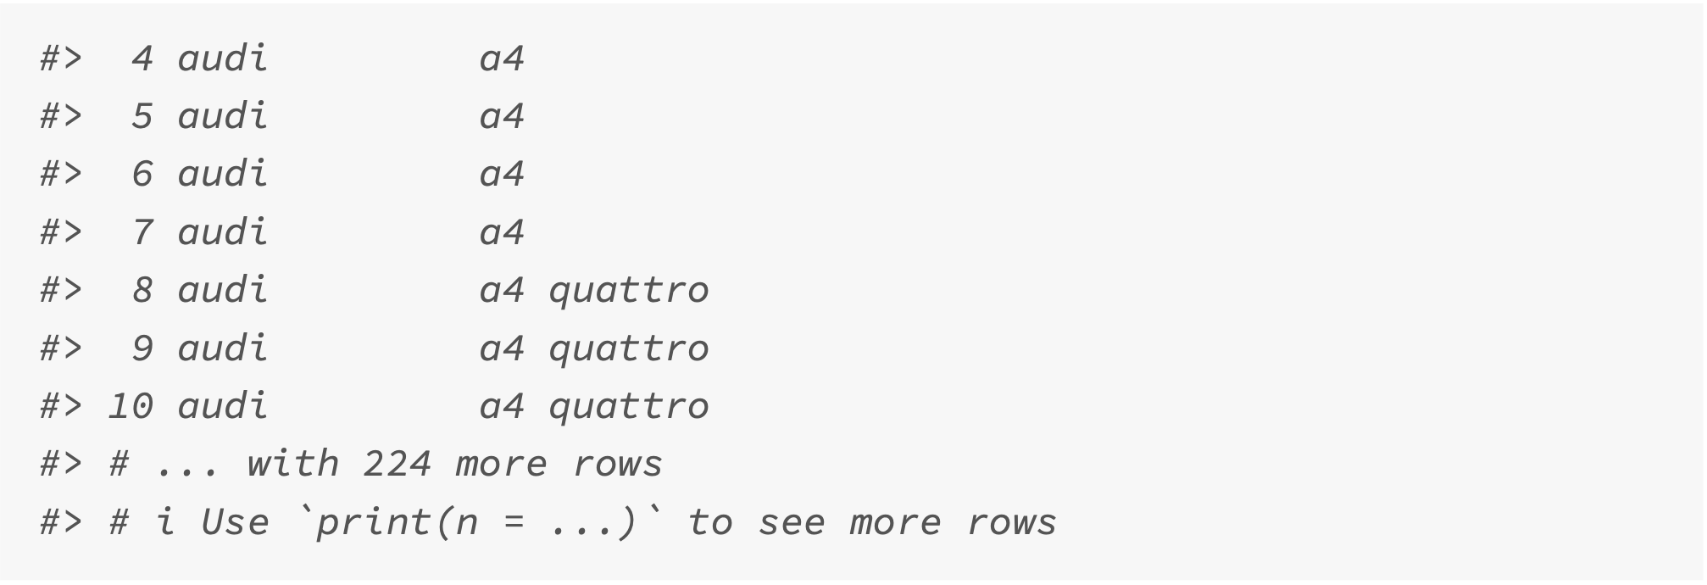
Selection helper: starts_with()

Slide 17
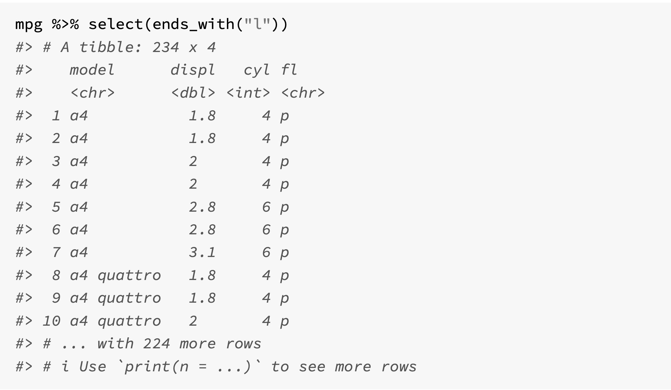
Selection helper: ends_with()

Slide 18
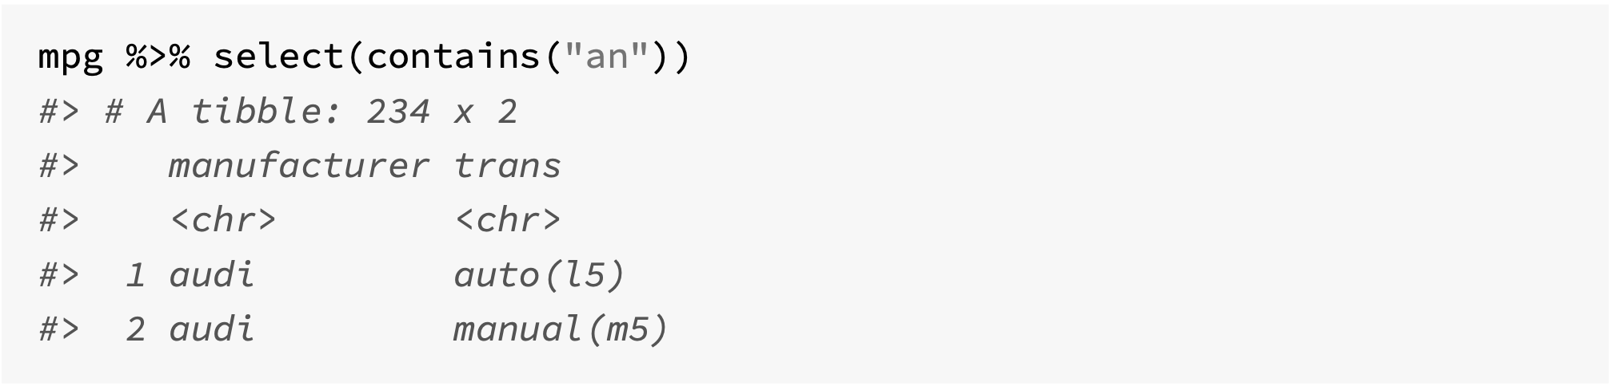
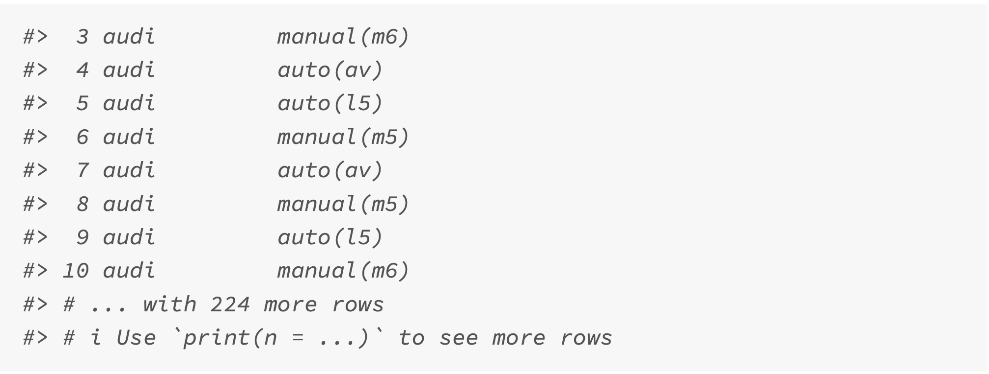
Selection helper: contains()

Slide 19
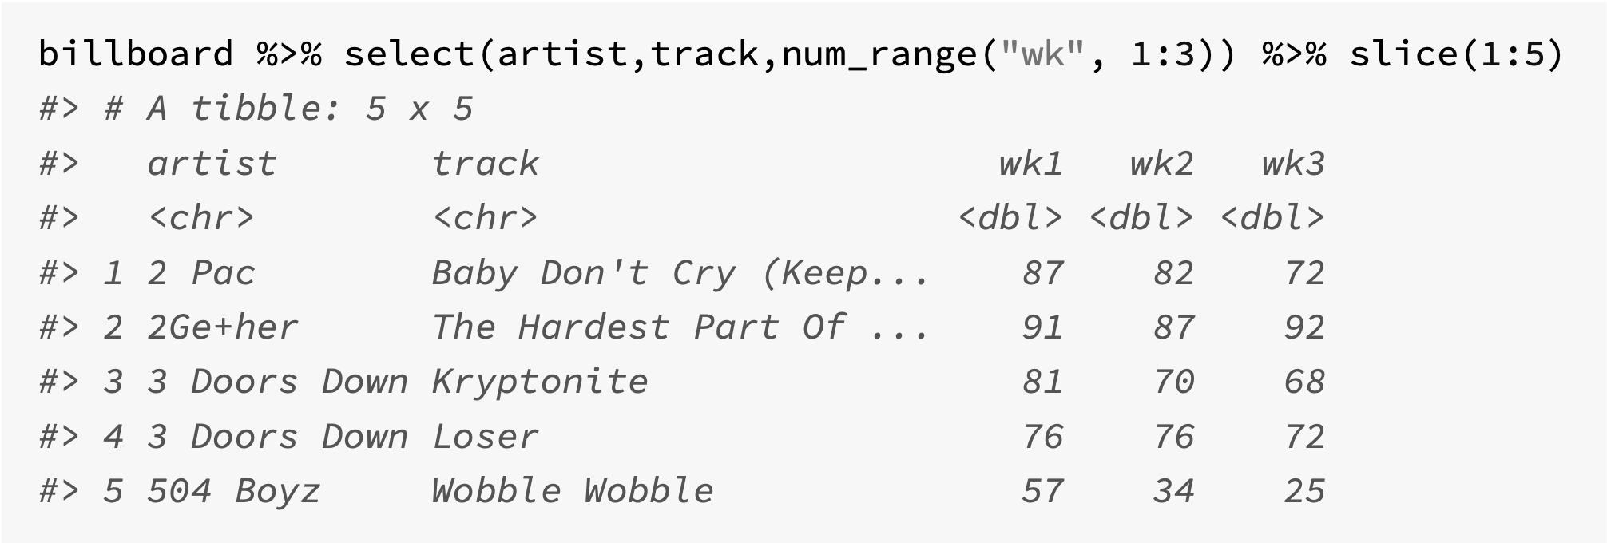
num_range() – prefix followed by numbers

Slide 20
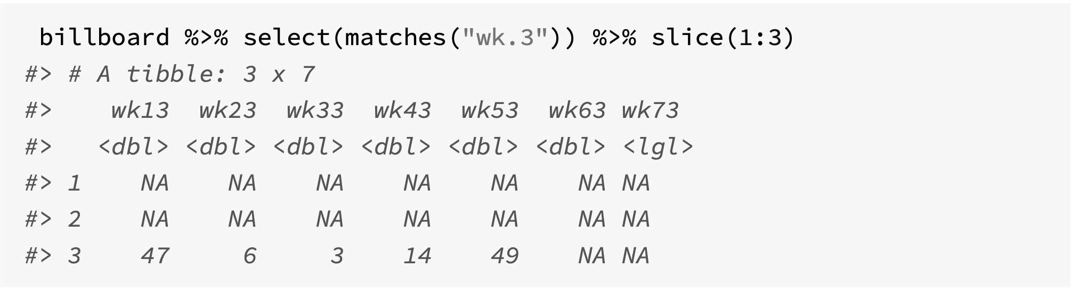
matches() – matches a regular expression pattern
The pattern here is to find a column that starts with “wk” and then contains any character (“.”) and concludes with the character “3”.

Slide 21
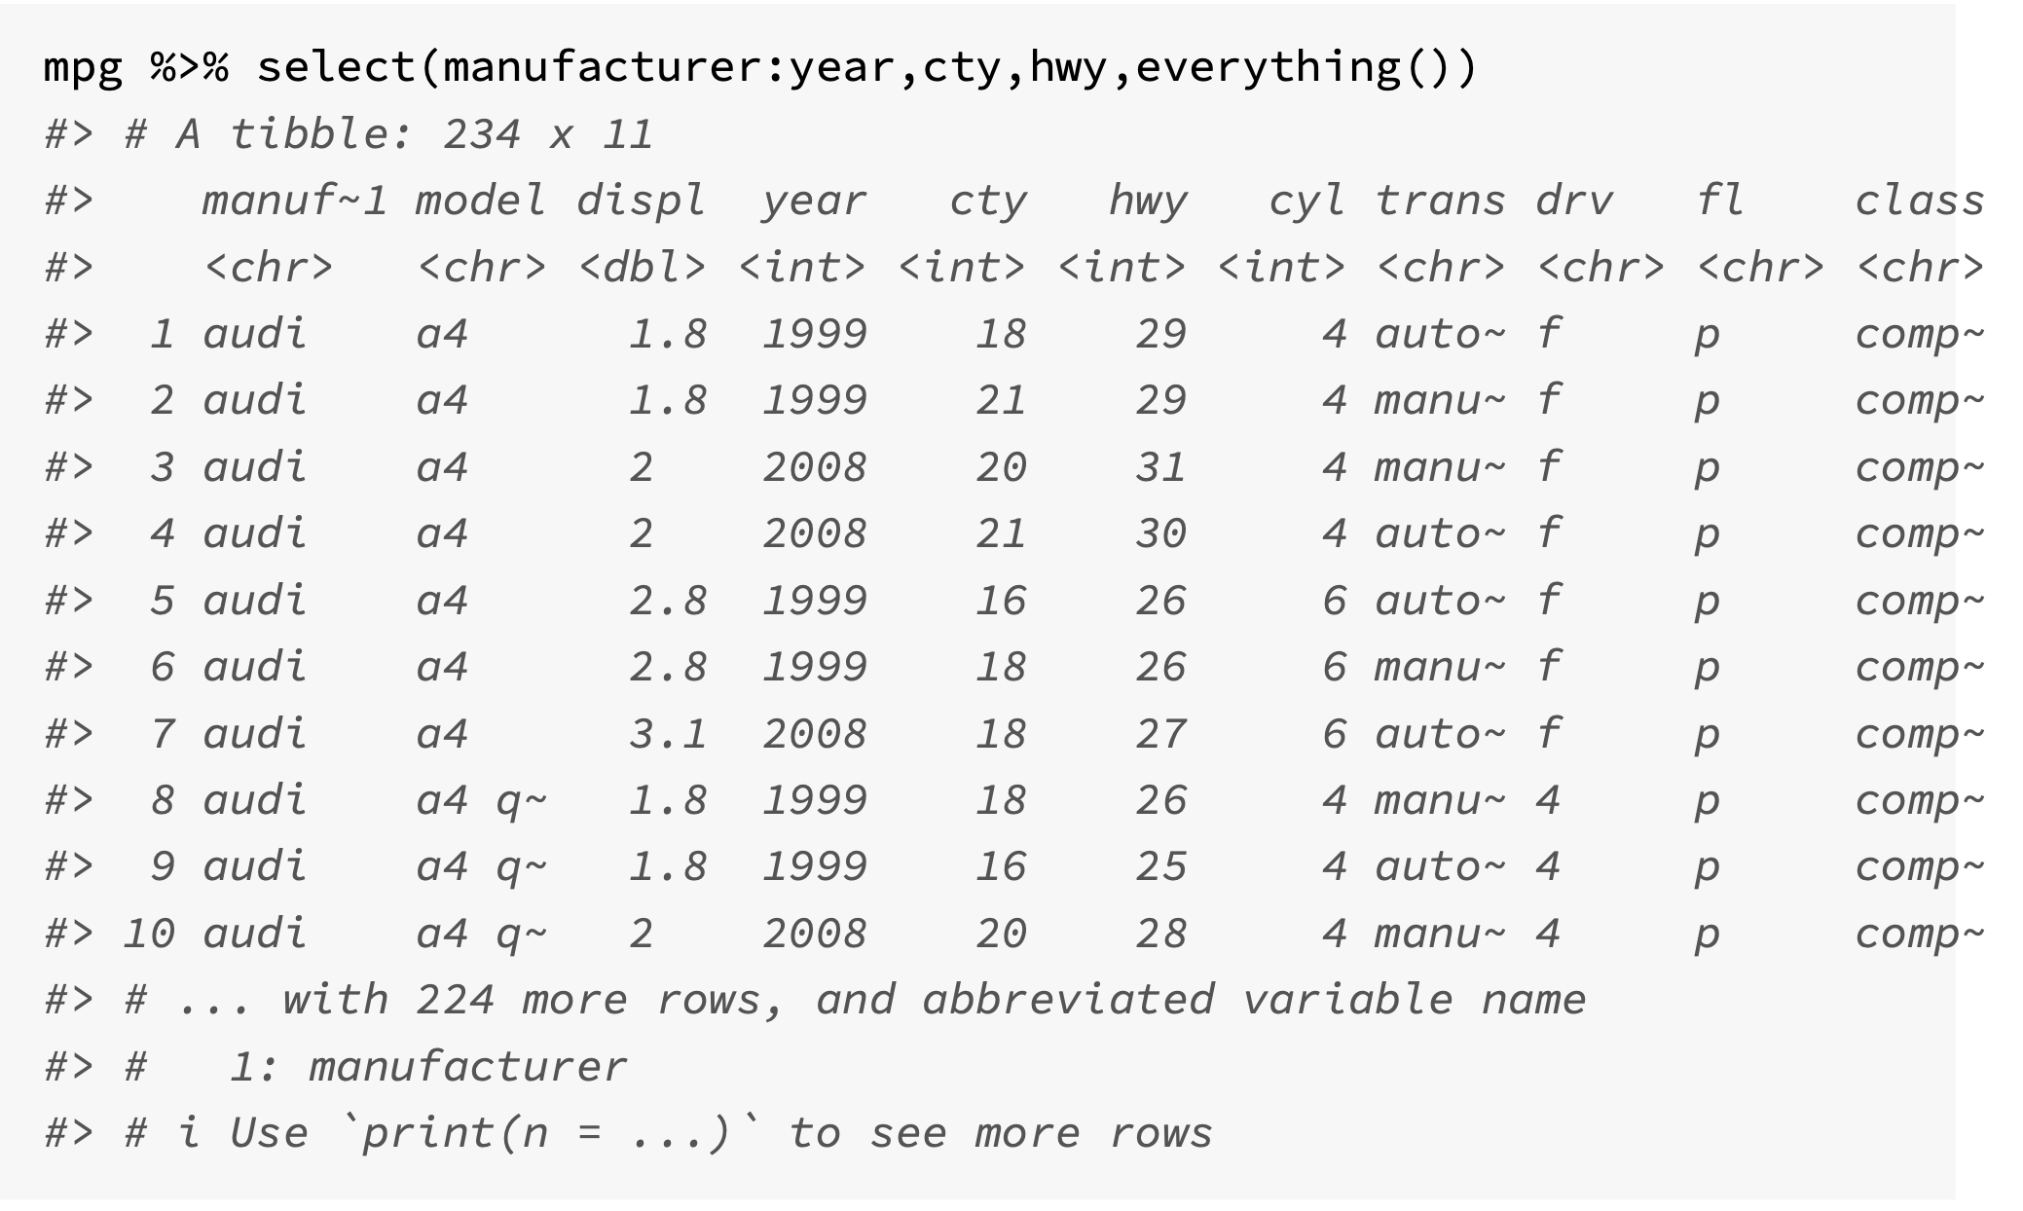
everything() – matches all remaining columns

Slide 22
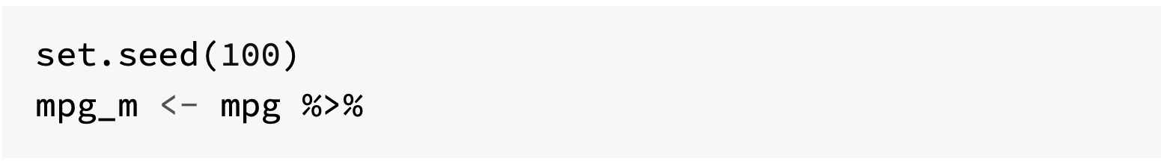
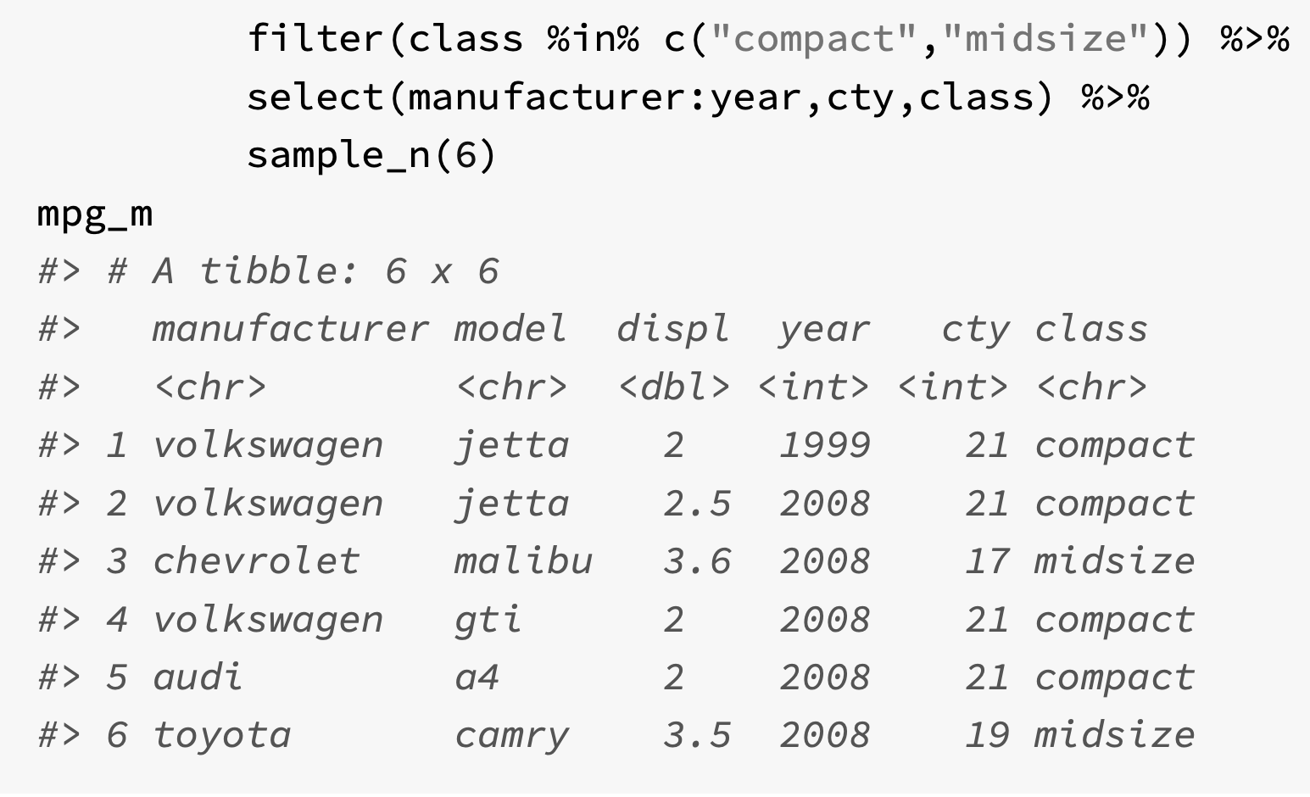
(4) Adding columns with mutate()
The function mutate() adds new variables to a tibble, while keeping the original ones
It also allows for variables to be overwritten, and variables can be deleted by setting their values to NULL
Arguments:
tibble that is to be transformed
name-value pairs. Which can be a vector of length 1 (then recycled), a vector of the same length as the tibble, or NULL.

Slide 23
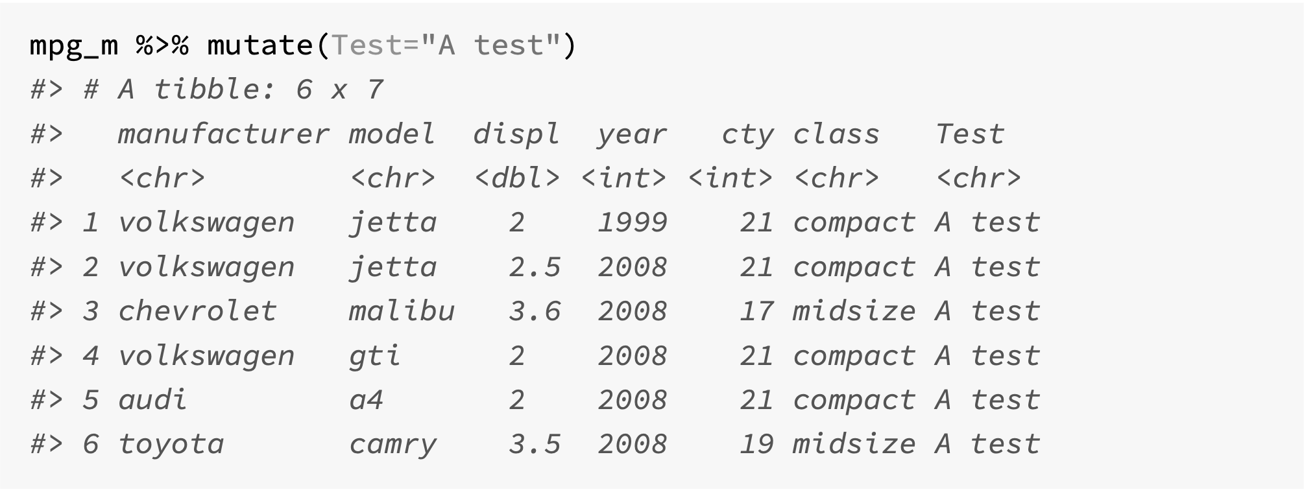
Adding vector of size 1

Slide 24
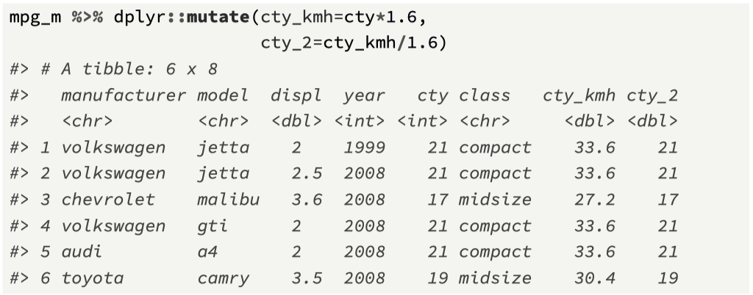
Adding a vector of the same length

Slide 25
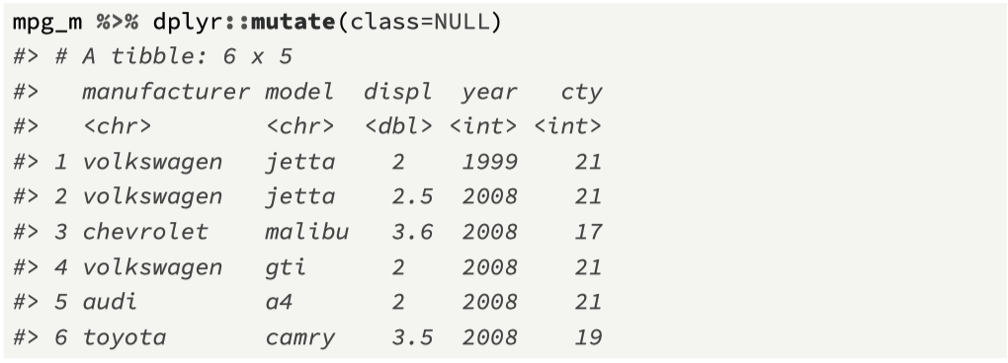
Remove a variable from a tibble (=NULL)

Slide 26
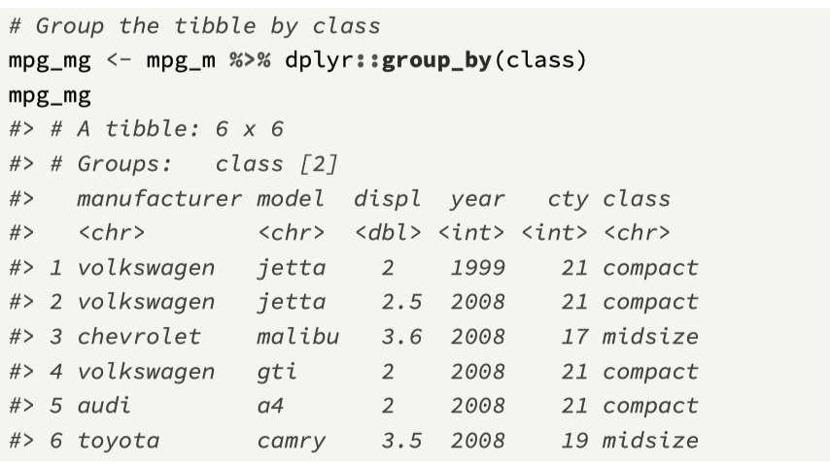
Using group_by() with mutate
Another function that can be used with mutate() is group_by() which takes a tibble and converts it to a grouped tibble, based on the input variable(s).
Computations can then be performed on the grouped data.

Slide 27
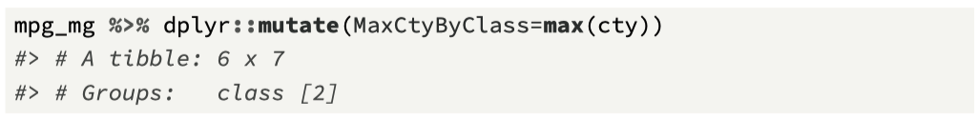
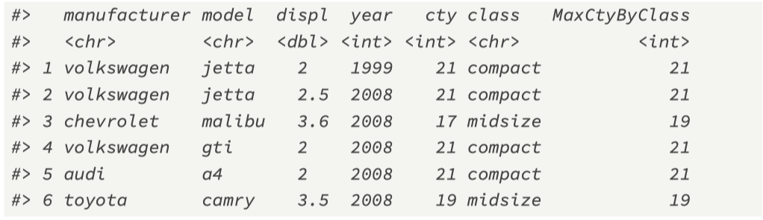
Using mutate() with group_by()

Slide 28
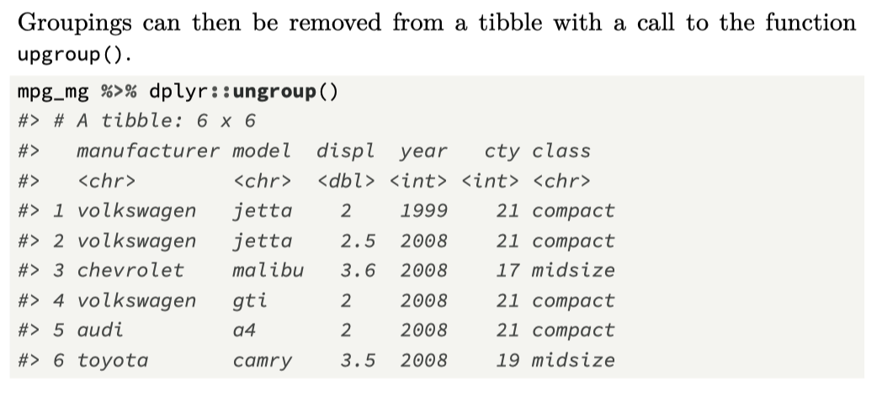
Remove groupings with ungroup()

Slide 29
(5) Summarising data with summarise()
The function summarise() creates a new tibble.
It will have one (or more) rows for each combination of grouping variable.
If there are no groupings, then a single row summary of all observations will be displayed.
Typically, summary functions are applied to the groups
The original data frame is “collapsed” into fewer values, keyed by the group name(s).

Slide 30
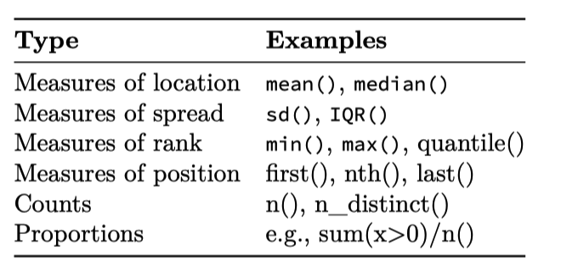
summarise() arguments
The arguments passed to summarize() include:
The tibble/data frame, which will usually have group attributes defined.
Name-value pairs of summary functions, where the name will be that of the column in the result. Summary functions include (Wickham and Grolemund, 2016):

Slide 31
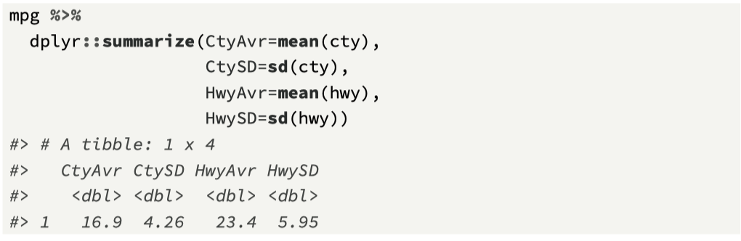
summarise() with no grouping

Slide 32
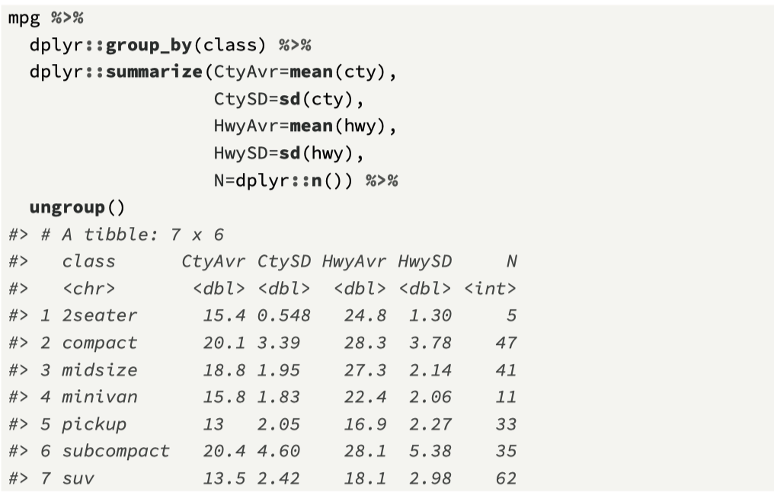
summarise() with a group.

Slide 33
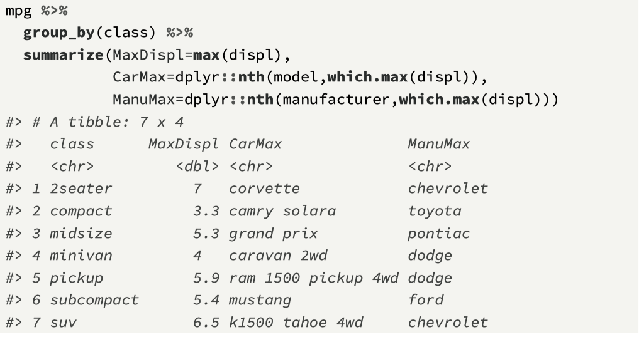
Extracting additional information from groups

Slide 34
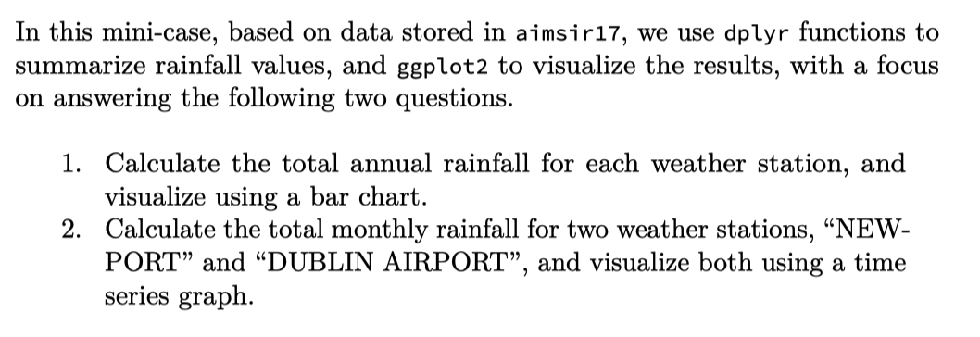
dplyr mini-case

Slide 35
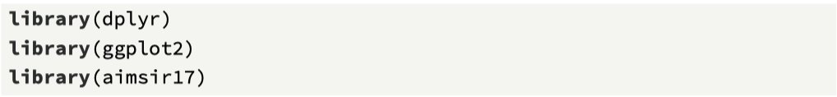
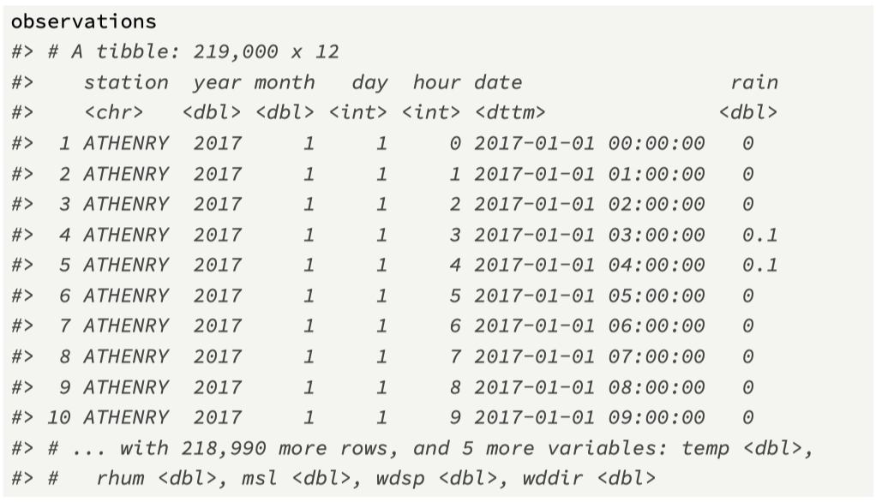
Check the observations tibble

Slide 36
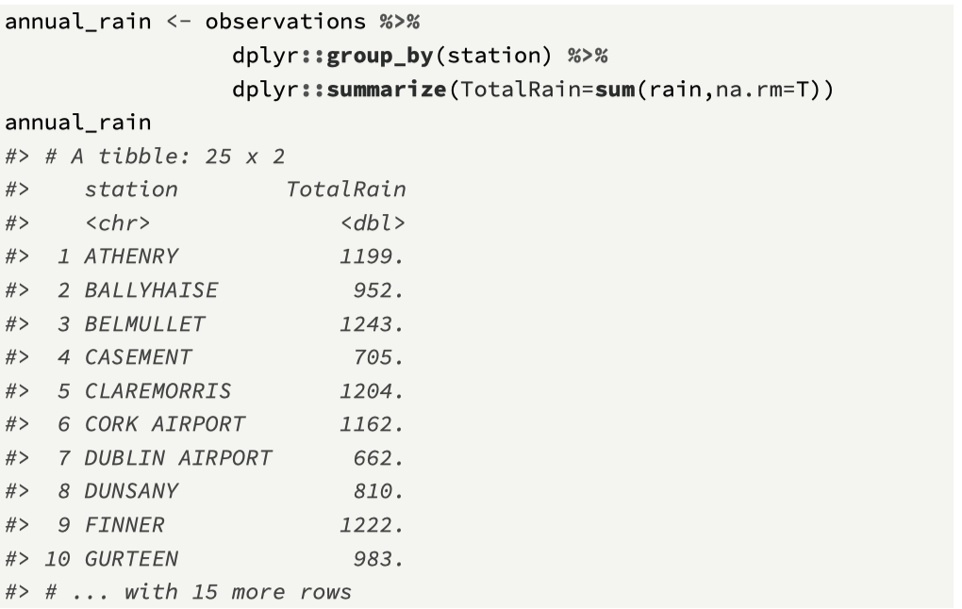
Summarising the data… 25 rows, why?

Slide 37
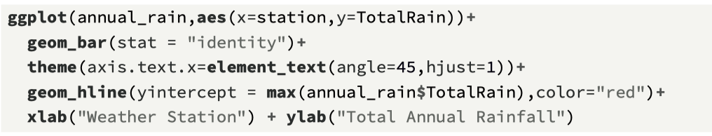
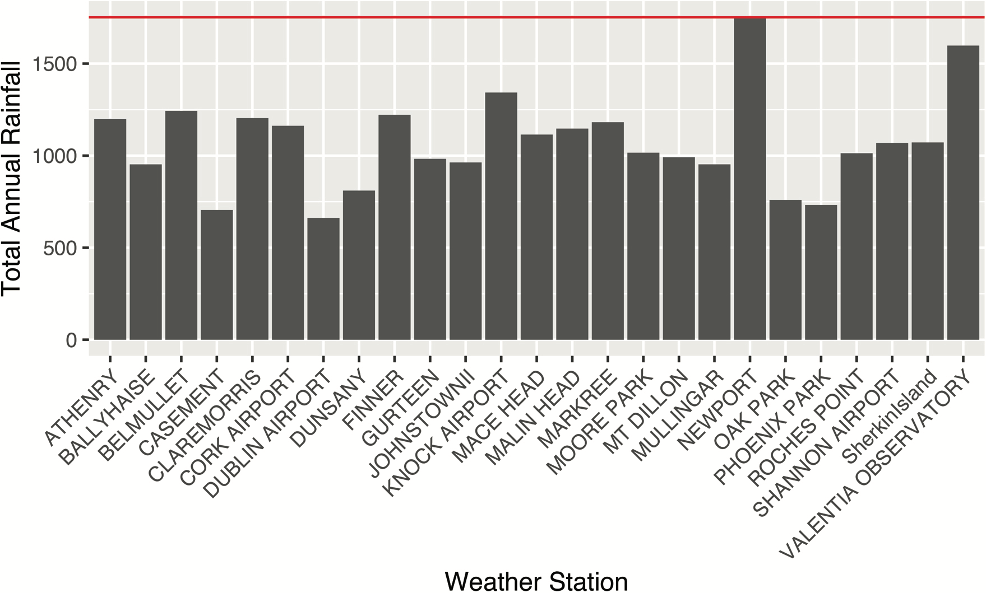
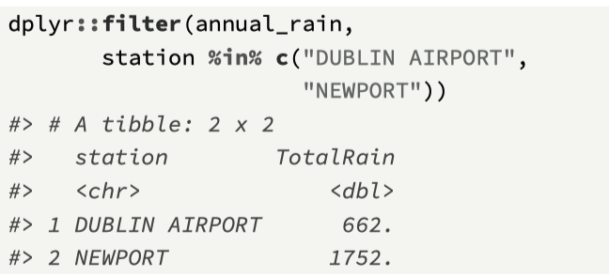

Slide 38
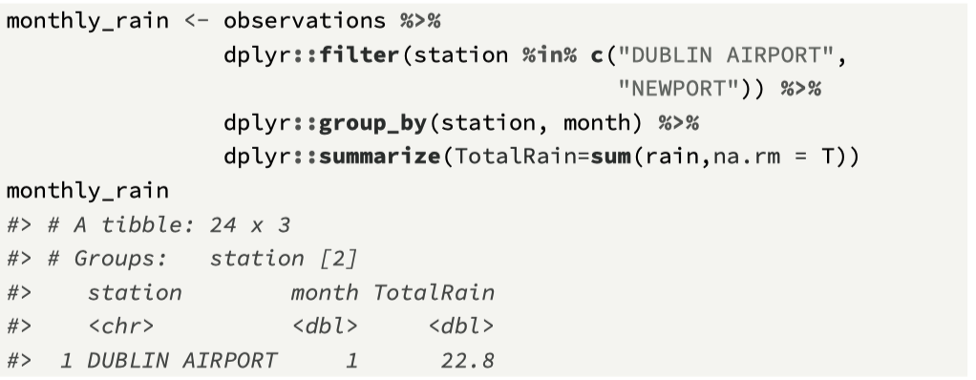
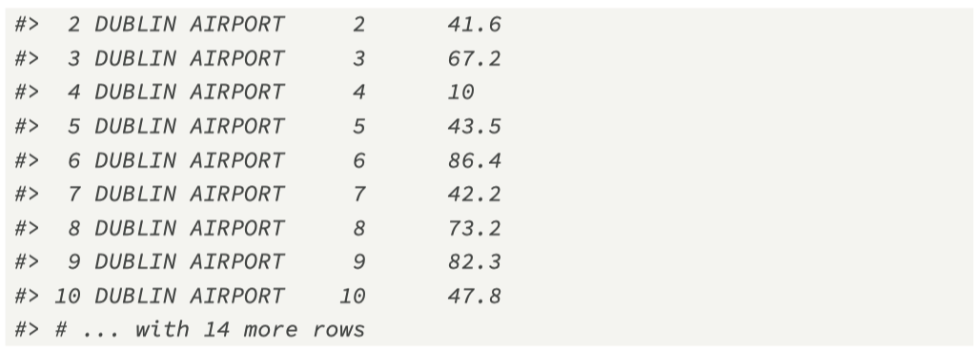

Slide 39
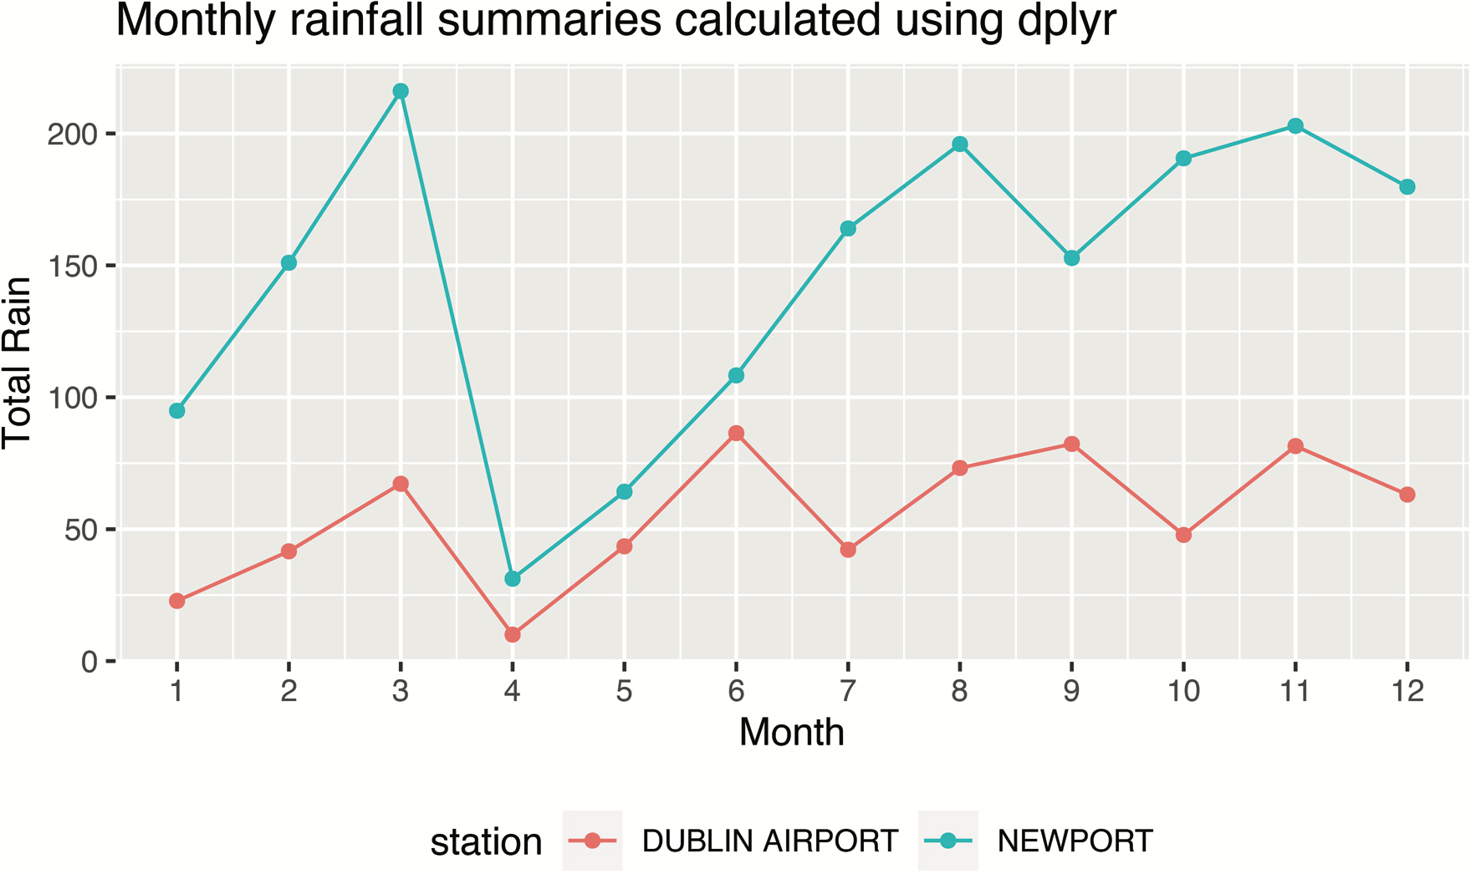
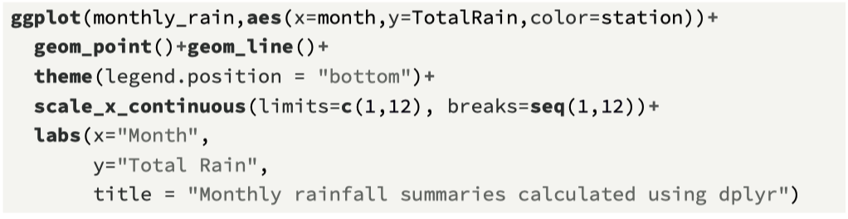

Slide 40

(6) Additional dplyr functions case_when()
The function case_when() enables you to implement similar code to the ifelse() function.
The arguments are a sequence of two-sided formulas, where the left-hand side (LHS) is used to formulate a condition, and the right-hand side (RHS) provides replacement values.
If the condition is TRUE, the RHS value is allocated, and no other conditions are evaluated
The symbol ~ separates the two sides.
TRUE at the end provides a default value

Slide 41


Slide 42

The pull() function
A feature of the dplyr is that the functions we’ve explored always return a tibble.
However, there may be cases when we need to return just one column, and while the $ operator can be used, the function pull() is a better choice, especially when using pipes.
In this example, an atomic vector is returned

Slide 43

Exercise 1

Slide 44


Exercise 2

